Slide 1

Unilever Performance in Alignment with Egypt
Vision 2030
Presented by :
1- Asmaa Magdy
2- Ahmed Hossam El-din
3- Sondos Hassan

Slide 2
Content
Project Overview
01
04
Business Analysis
FMCG Market Analysis
02
05
Sustainability
Unilever Structure
03
06
Egypt 2030 Vision

Slide 3
Project Overview
01

Slide 4
Problem
Solution
Problem
Egypt Vision 2030 sets a comprehensive framework for sustainable development. The FMCG market, which accounts for approximately 30% of total retail activity in Egypt, is a major contributor to economic and social progress. However, a unified dashboard that links FMCG market performance to Vision 2030 objectives is still missing.
create a unified visualization tool that uses Unilever as a representative case to evaluate how an FMCG company’s financial, social, and environmental performance aligns with the pillars of Egypt Vision 2030. This approach demonstrates a scalable model that other market players can adopt.

Slide 5
FMCG Market Analysis
02

Slide 6

Market Analysis
Top 10 FMCGs Company per Revenue
Why Unilever is our Case ?
- Volume growth - Emerging markets
- Renewable Energy - Plastic Reduction

Slide 7
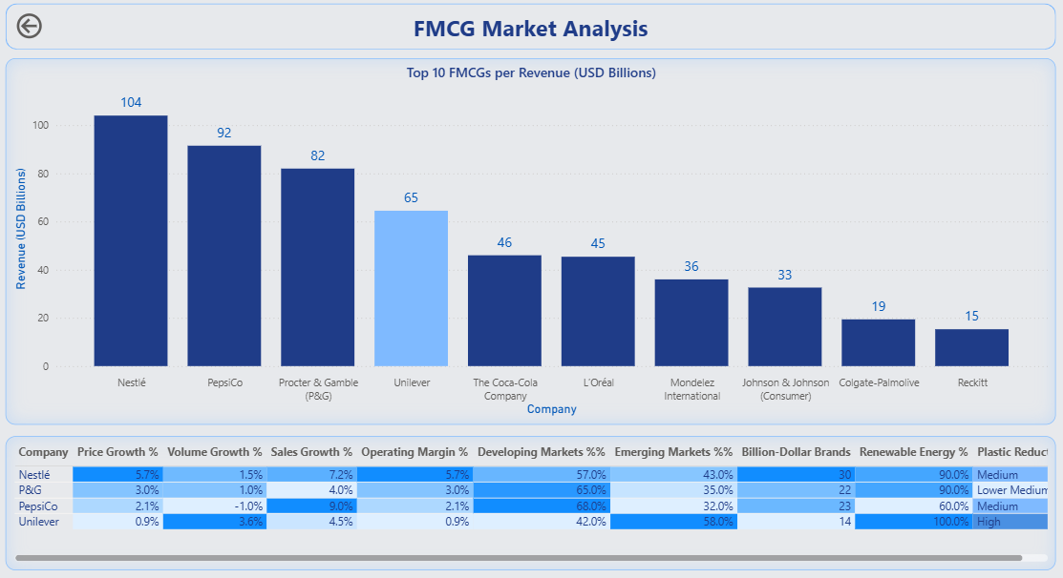

Slide 8
Unilever Structure
03

Slide 9

Unilever Structure
- Age Distribution
- Gender Distribution
- Region Distribution

Slide 10
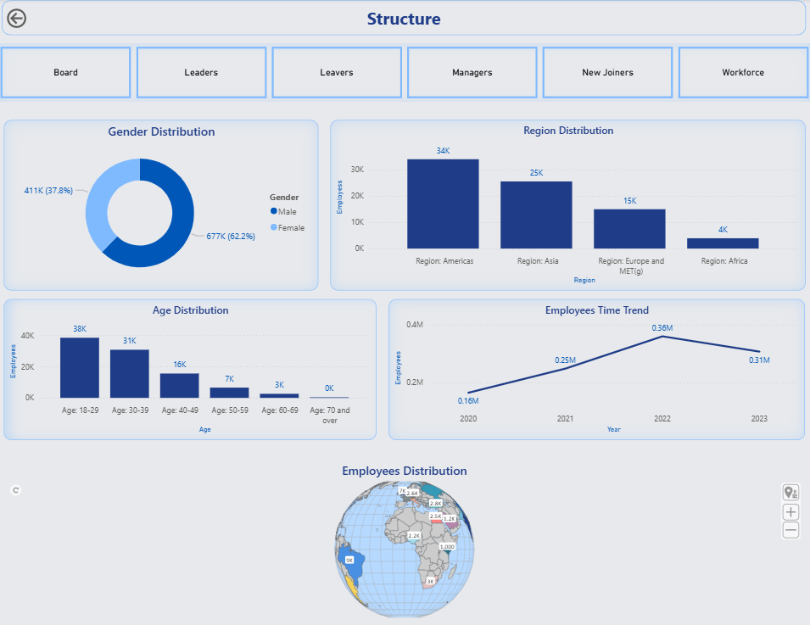

Slide 11
Business Analysis
04

Slide 12
Product Segments
20%
26%
Home Care
Food & Refreshment
23%
30%
Personal care
Beauty

Slide 13
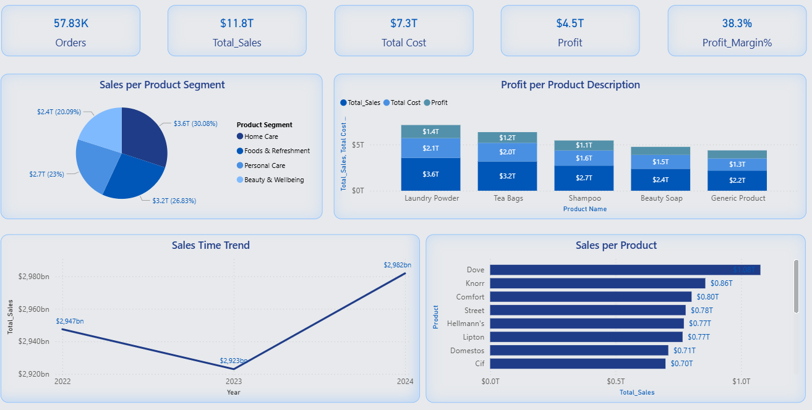

Slide 14
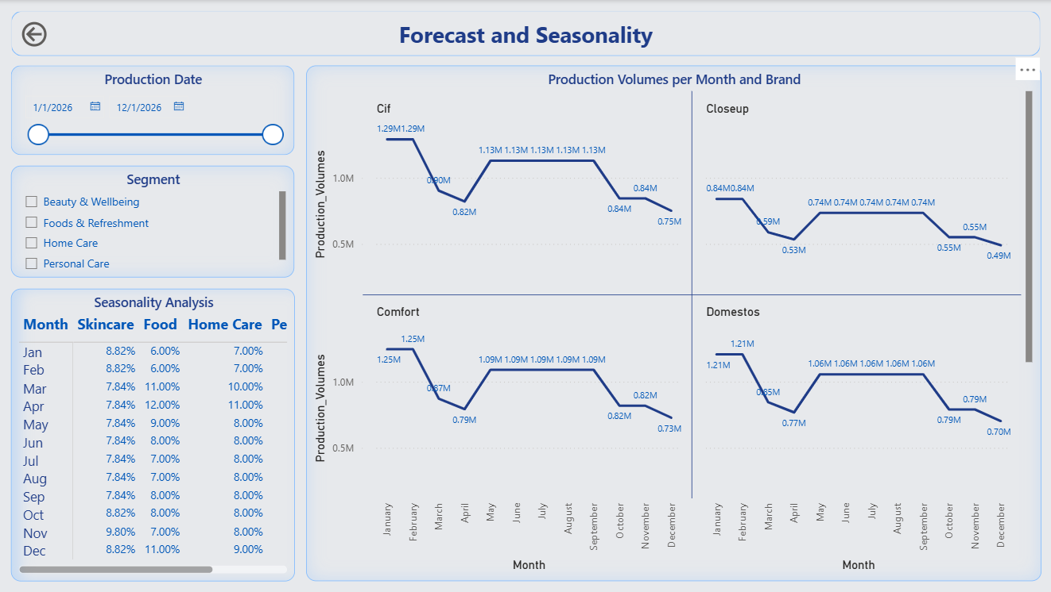

Slide 15
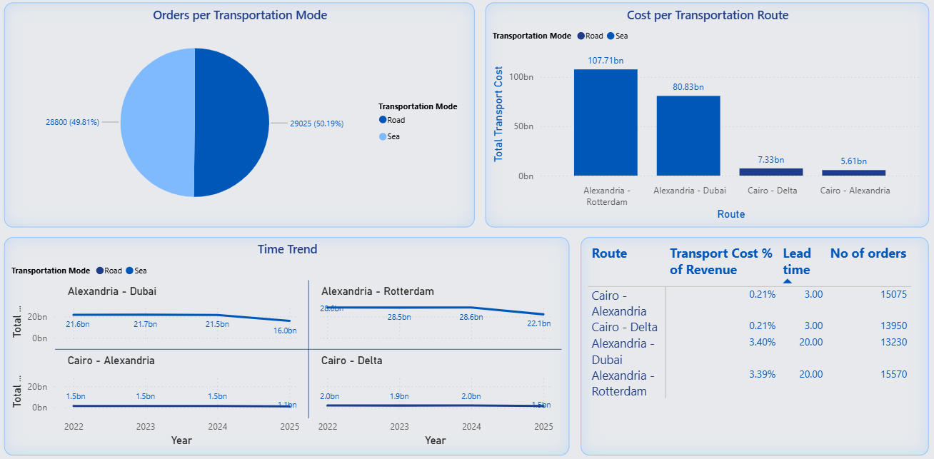
Transportaions

Slide 16
Sustainability
05

Slide 17
Sustainability
Water
Waste
Energy
Gas Emissions
Social
Economic
54% reduction in water use
34% reduction in Waste
24% reduction in energy use
74% reduction in emissions
Empowering communities and people
Strengthening supply chain livelihoods

Slide 18
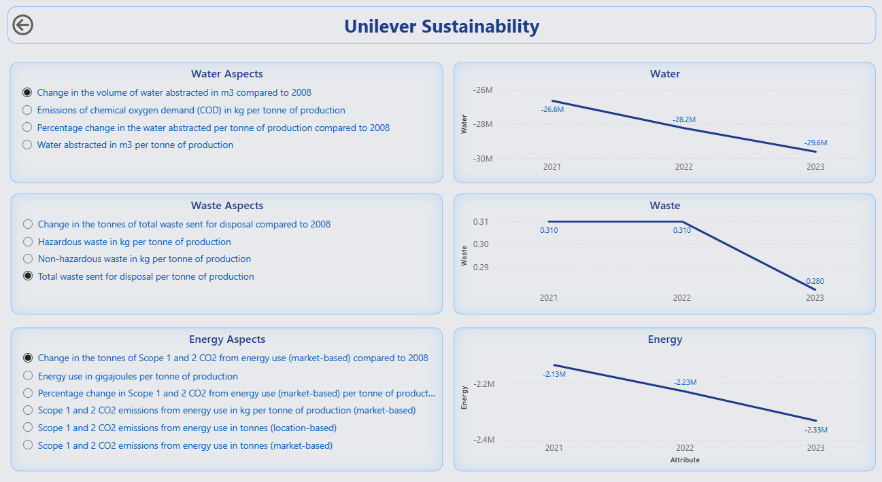

Slide 19
Egypt 2030 Vision
06

Slide 20
Egypt 2030 Pillars Forecasted Impact on Unilever Revenue
13%
5%
4%
4%
Economic
Enviromental
Social
Market & Consumer Opportunities

Slide 21
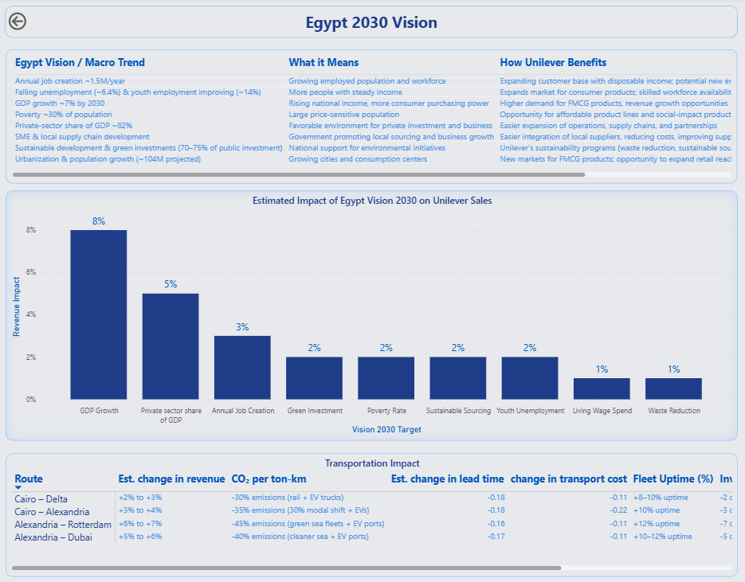

Slide 22
Sustainability Source : https://opennetzero.org/unilever
Revenue, Sales & Financial KPIs (Actual Company Data) • Source: Unilever Egypt (via parent Unilever Plc) • Links: - Unilever Annual Report 2023 - Unilever PLC Financials • Extracted: Revenue growth rates (2022–2023), FMCG segment shares. • Applied: Scaled down global revenues to Egypt operations size (~2–3% of Unilever MENA revenue).
Production & FMCG Market Volumes • Source: CAPMAS (Egypt Statistics) + Euromonitor FMCG Egypt reports. • Links: - CAPMAS Egypt - Euromonitor Egypt FMCG • Extracted: Packaged foods & home care market growth ~6–8% CAGR. • Applied: Monthly production volumes scaled from FMCG growth rates.
Transportation Modes & Costs • Source: World Bank Logistics Index, UNCTAD, Egypt news (fuel, trucking). • Links: - World Bank LPI - UNCTAD Shipping Data • Extracted: Road highest cost/kg, sea freight spike (2022–2023), air fastest but ~10× sea. • Applied: Estimated Transport cost (EGP) & Lead time (days) by mode/route.
Lead Times (Logistics Performance) • Source: Trading Economics + World Bank LPI 2023. • Links: - Trading Economics Egypt Logistics - World Bank LPI 2023 • Extracted: Road ~5–8 days, sea ~20–35 days, air 3–6 days. • Applied: Assigned Lead time (days) by transport mode.
Currency Source • Source: Central Bank of Egypt FX rates. • Links: - CBE Historical FX • Extracted: EGP baseline, inflation adjustments. • Applied: Currency_source column filled with 'CBE / Local EGP'. ■■ How I Combined the Data
Thanks

